Slide 1
CIRCLE Seminar
Session 4

Slide 2
Youth engagement is critical to sustaining democracy.
“Democracy has to be born anew every generation, and education is its midwife.”
Young people drive change in the US.

Slide 3
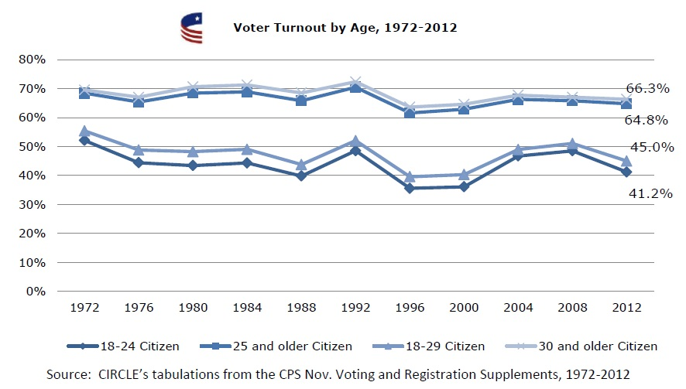
…but, we’re stuck.

Slide 4
We have discussed unequal opportunities & outcomes…
Civics well-taught in some advantaged communities, but much less so in schools that serve low-income and minority youth
White, wealthy students are 4-6 times more likely to exceed “proficient” in civics
7% of low-SES students reached “proficient.”
Notes:
The best experiences for students in affluent communities or on a college track

Slide 5
Despite big changes, the situation has not changed.
So we need to think beyond easy explanations and small adjustments…

Slide 6
We know more about what works…
Discussing current issues
Service-learning addressing “root causes”
Extracurricular participation
Being told to and taught to vote by a teacher

Slide 7
We need to support teachers…
24.8% of teachers thought that parents or other adults would object if politics was discussed in their government course
Notes:
Political debate is more confusing, alienating, and polarizing
Civic education is increasingly viewed as controversial

Slide 8
Involve families…
Parents’ encouraging their adolescent children to express opinions and disagreements predicted their electoral engagement, political knowledge, and informed voting in 2012.
Notes:
Political debate is more confusing, alienating, and polarizing
Civic education is increasingly viewed as controversial

Slide 9
Innovation
Better state standards
Support teachers’ obligation to include discussions of current issues
Lower the voting age to 17
Badges for excellence in civics
Notes:
Entirely new approaches. For example:
Support teachers’ obligation to include discussions of current, controversial political issues
Lowering the voting age to 17 in municipal or state elections

Slide 10
Collaboration
Statewide coalitions, as in CA, FL, IL
Align civics and voting laws
Assign students to discuss news at home
Badges awarded by schools and others
Notes:
Multi-sector, over time, focused on quality:
Align civics and voting laws (with pre-registration)
Employers highly value skills that students learn from civic engagement.

Slide 11
To break this pattern,
we need innovation
and collaboration…

Slide 12
and YOU.

Slide 13
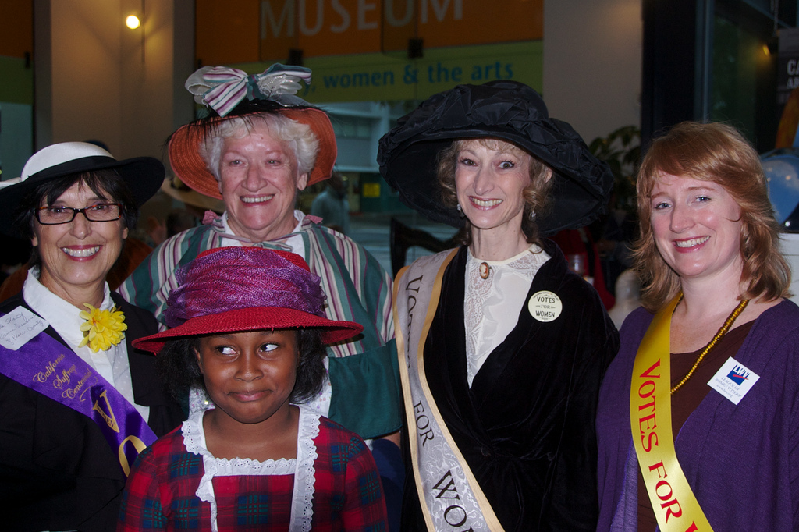

Slide 14
Commission on Youth Voting and Civic Knowledge
Data on 6,913 people in total
Including teachers (720), stakeholders, and young people
Scan of state policies relevant to voting, voter registration, social studies, civics, teacher certification and school performance indices

Slide 15
Some of our findings:
Some of the standard reform proposals are actually misconceived
But educating and engaging young people has long term effects
Effective practices develop skills as well as knowledge
Yet there are major gaps in exposure and quality
Strengthening civic education requires more support of teachers

Slide 16
Some of our findings:
Some of the standard reform proposals are actually misconceived
But educating and engaging young people has long term effects
Effective practices develop skills as well as knowledge
Yet there are major gaps in exposure and quality
Strengthening civic education requires more support of teachers

Slide 17
Commission on Youth Voting and Civic Knowledge
Distinguished, interdisciplinary group
Funded by S.D. Bechtel, Jr. Foundation, the W.T. Grant Foundation, the Robert R. McCormick Foundation, the Spencer Foundation, and the Youth Engagement Fund
Notes:
A bit of background on this report.
Some detail on type of individuals included

